Slide 1

Trading With ML: Classification and SVM

Slide 2
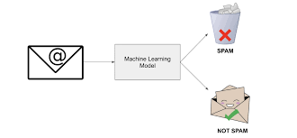
Binary (Binomial) Classification
Used in situation you need to predict an outcome in which can take two distinct values
Yes or no
Positive or negative
0 or 1

Slide 3
Binary (Binomial) Classification
h(x)>t:+
h(x)<t:-
Response Function h(x)
Input
Treshold Value

Slide 4
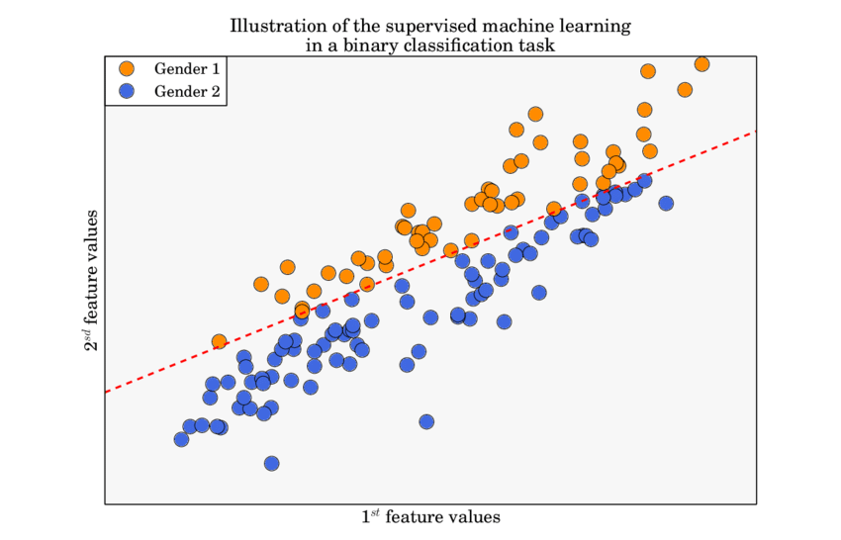
Binary (Binomial) Classification
Supervised learning since the training dataset is labelled

Slide 5
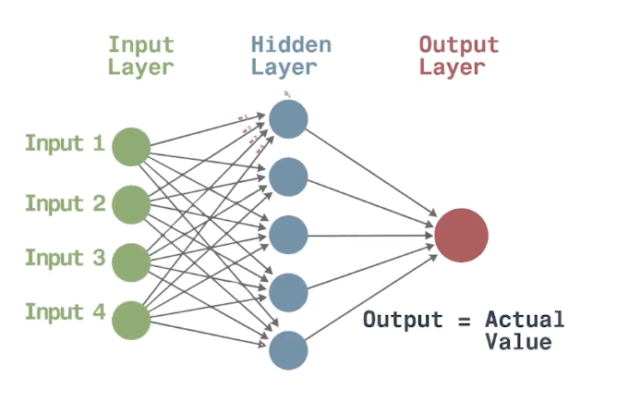
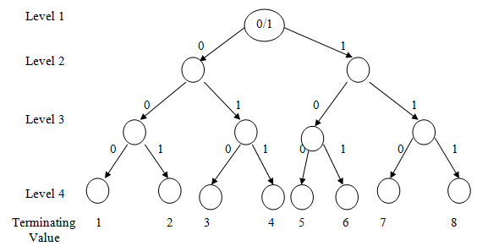
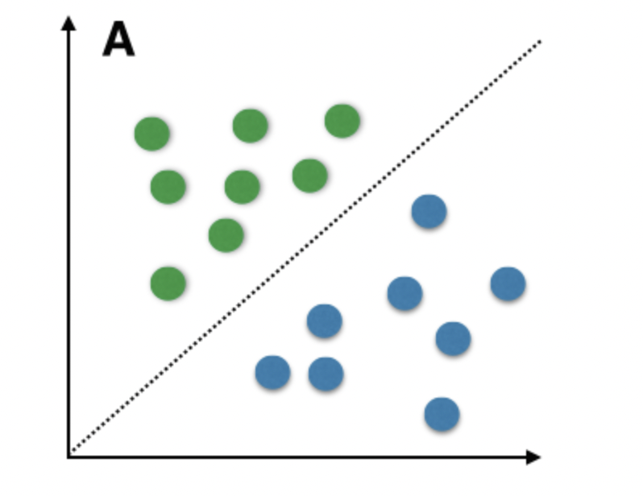
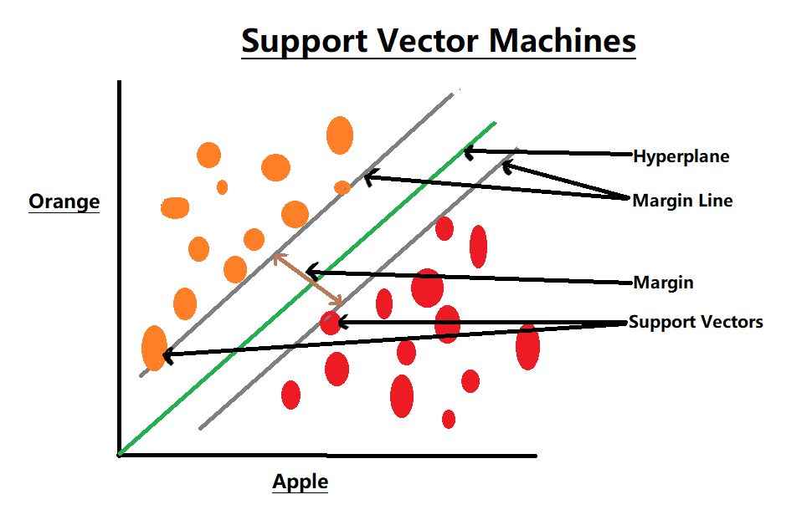
Paradigms
Decision trees
Neural networks
Bayesian classification
Support vector machines

Slide 6
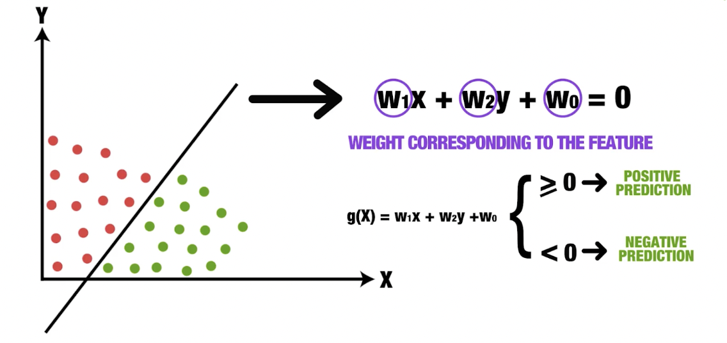
Linear Binary Classifier
The aim of the linear classifier is to arrive at a straight line separating the space into two halves, such that the positive and negative outcomes lie on either side of the line.
The aim of the learning process is to construct a good weight vector. (max the probability of making correct predictions)

Slide 7
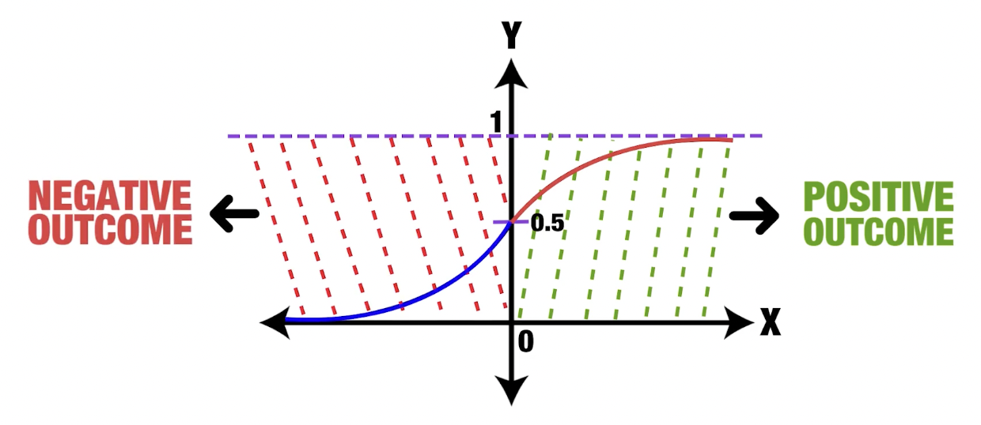
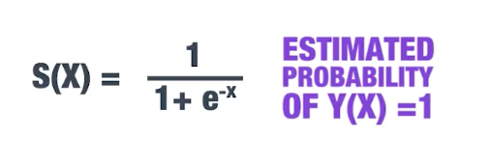
Sigmoid Function
S shaped
Bounded

Slide 8
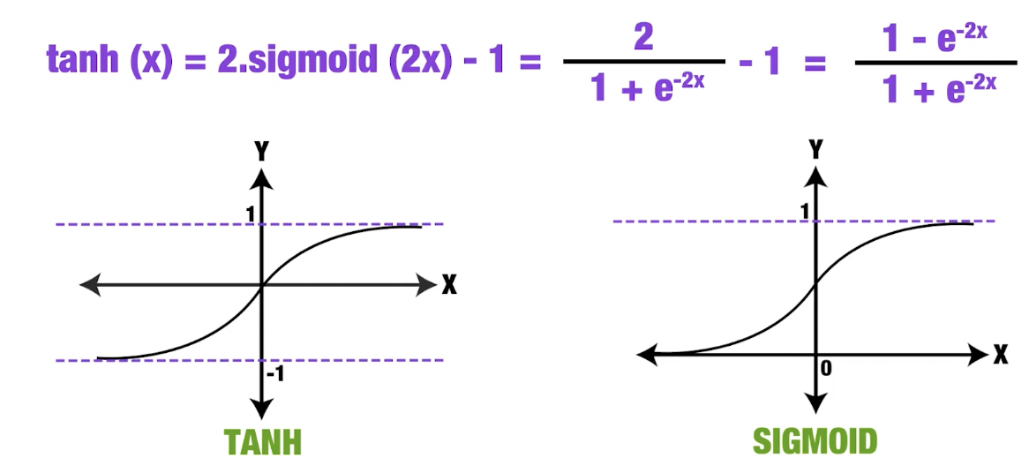
Hyperbolic Tangent Function (tanh(x))
Also:
S shaped
Bounded

Slide 9
Cost Function
Measures how far off predictions are from actual outcomes.
Used to find the best parameters (θ) to minimize prediction error.
Common Forms:
Linear regression:
Cost = ½ (hθ(xᵢ) − yᵢ)²
Logistic regression (classification):
Cost(hθ(x), y) = -y·log(hθ(x)) − (1−y)·log(1−hθ(x))
Ensures the cost is convex, so gradient descent can find the global minimum.

Slide 10
Gradient Descent
Algorithm to minimize the cost function by updating each θ value:
θⱼ := θⱼ − α × (∂/∂θⱼ) J(θ)
α is the learning rate:
Too small → slow learning
Too big → unstable results or divergence
The goal is to reach the minimum of the cost function, where the model performs best.

Slide 11
Predicting Market Movement
1: market moved upward
-1 :market moved downward
Historical price data
Feature vector
Binary classsification

Slide 12
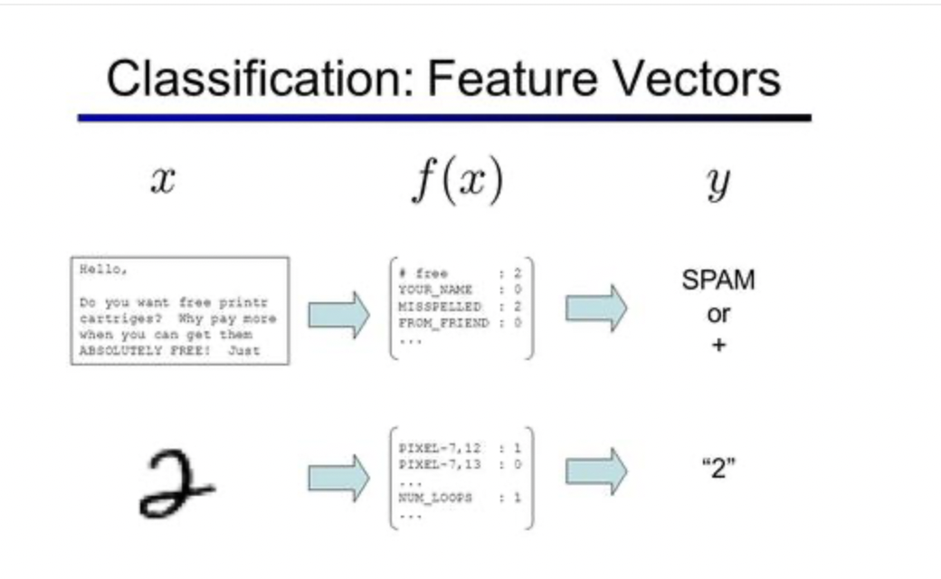
Feature Vector
High correlation and positive difference: upward movement
High correlation and negative difference: downward movement

